Slide 1

CUSTOMER TARGETING & PREDICTING CONVERSION RATES FOR TERM DEPOSITS
December 2022

Slide 2





PROJECT EXECUTION TEAM
Team 6
Siddi,
Nikhitha
Turkel,
Amisha
Padmaraju, Manoj
Kriplani,
Mahima
Shirodkar,
Sharan

Slide 3
AGENDA
Executive summary
DATA SUMMARY & Methodology
Business
problem
DESCRIPTIVE ANALYSIS
SEGMENTATION & TARGETING
Predicting conversions
CONSCLUSIONS & Recommendations

Slide 4

Business Problem & EXECUTIVE SUMMARY

Slide 5





EXECUTIVE SUMMARY
Objective : The objective is to increase term deposit subscriptions by strategically targeting the right group of customers through effective marketing efforts, as well as predicting if clients will enroll to a subscription.
PROCESS
OUTCOMES
NEXT STEPS
Univariate & Bivariate Analysis
Regression modelling for predictions
Clustering of customers to identify unique customer profiles
Target Customer Profiles
Students Retirees
Built a robust machine learning classification model to predict client term deposit subscription
In order to better capture macroeconomic variable effects, more time-based data needs to be collected
Design test group experiments to capitalize on large customer groups with low subscription rates

Slide 6
To optimize marketing efforts and maximize ROI, the bank needs to identify the right kind of customer to target with their term deposit offering and be able to predict whether the client will subscribe to the term deposit or not .
PROBLEM STATEMENT
Current State
Future State
Context: The Term Deposits team at a Portuguese banking institution is looking to optimize their marketing spend
Trigger: The bank does not know the kind of customer best suited to secure term deposits and whether the client will subscribe to the term deposit
Action: The team needs a data driven approach to identify the right customer profiles
Outcome: Term Deposits team is able to spend effectively on marketing efforts that target the right kind of customers
Behaviour: The team uses the approach and the recommendations from it to understand the apt customer
Insight: The framework built identifies the most important factors for conversion and the customers with the best attributes in them
Gap
The team needs to identify the factors that contribute to securing a term deposit

Slide 7



Introduction | A Portuguese Bank has data available from a recent campaign, and wants to use it for a more complex marketing approach
PROJECT OBJECTIVE (1/2)
Identifying the Right Customer
Prediction of Conversion
Product Recommender
To optimize marketing efforts, budget must be spent on reaching out to the right kind of customer
Performed EDA to generate insights on which kind of customers are most likely to secure term deposits. Clustering models will help identify groups of customers similar to each other which will aid in targeted marketing.
The ability to forecast conversion will help target the right customers with the best suited marketing approach
With the data available, classification models can be built that will identify the factors that are important to conversion and the likelihood of the same
Customer level data available can be used to identify customer-product suitability
The data available can be used to develop customer profiles and match them with the right kind of products provided by the bank

Slide 8



PROJECT OBJECTIVE (2/2)
OBJECTIVE 3
Build a framework to predict conversion rates
OBJECTIVE 2
Identify important factors that drive conversion rates for better data capturing mechanism
OBJECTIVE 1
Identify potential segments of customers to optimize marketing efforts

Slide 9

Data Summary & Methodology

Slide 10
Data Understanding | The data available is a mix of customer data, campaign-based data and social & economic variables
These variables detail some of the customer’s personal information as well as their relationship with the bank
Age
Marital Status
Credit Default
Customer
Personal Loan
Job
Education
Housing Loan
These variables detail the bank’s interaction with the customer during this campaign, as well as the before it
Contact Type
Contact Duration
Campaign no. of Contacts
Before Campaign no. of Contacts
Campaign
Last Contact Month
Last Contact Day of Week
Days after Last Contact
Previous Campaign Outcome
These variables describe the prevalent economic situation at the time of last contact through financially relevant metrics
Employee Variation Rate
Consumer Confidence Index
Number of employees
Socio-economic
Consumer Price Index
Euribor 3 Month Rate
This variable talks about the outcome of the campaign for the customer i.e., did they secure a term deposit or not
Outcome
Outcome Variable → y

Slide 11
PROCESS METHODOLOGY- ROADMAP
1
Descriptive Analysis
Univariate and Bivariate analysis to unearth existing business patterns
2
Data Sourcing
Procure marketing campaign data that aimed to promote term deposits among existing customers of a Portuguese bank
3
Predictive Analysis
Develop segments of customers based on their response to campaign
Build a system to predict subscription outcome based on customer responses
Develop Strategy
Identify variables that dictate subscription rates to inform better data capturing mechanism
Leverage analysis findings & predictive system to gauge outcome of future campaigns
4

Slide 12

Descriptive statistics and business patterns

Slide 13
Numeric Variables - Univariate
Variable | Range | Minimum | Maximum | P1 | P99 | Iqr | Mean | Median | Stdv
age | 81 | 17 | 98 | 23 | 71 | 15 | 40 | 38 | 10
duration | 4918 | 0 | 4918 | 11 | 1271 | 217 | 258 | 180 | 259
campaign | 55 | 1 | 56 | 1 | 14 | 2 | 3 | 2 | 3
pdays | 999 | 0 | 999 | 3 | 999 | 0 | 962 | 999 | 187
previous | 7 | 0 | 7 | 0 | 2 | 0 | 0 | 0 | 0
emp.var.rate | 5 | -3 | 1 | -3 | 1 | 3 | 0 | 1 | 2
cons.price.idx | 3 | 92 | 95 | 92 | 94 | 1 | 94 | 94 | 1
cons.conf.idx | 24 | -51 | -27 | -50 | -27 | 6 | -41 | -42 | 5
euribor3m | 4 | 1 | 5 | 1 | 5 | 4 | 4 | 5 | 2
nr.employed | 265 | 4964 | 5228 | 4964 | 5228 | 129 | 5167 | 5191 | 72
Before starting with the analysis, we consider the below 2 factors to remove variables that do not add any value to our analysis
If >99% values are missing in the dataset, we will drop the variable.
If p0.1=p0.99 i.e. if the 1st percentile and 99th percentile for a given variables is same, it means there is no variability. Hence, we can safely drop such variables.

Slide 14
Categorical Variables - Univariate
Variable | Number of levels | Missing criteria flag | Select
job | 12 | 1 | 1
marital | 4 | 1 | 1
education | 8 | 1 | 1
default | 3 | 1 | 1
housing | 3 | 1 | 1
loan | 3 | 1 | 1
contact | 2 | 1 | 1
month | 10 | 1 | 1
day_of_week | 5 | 1 | 1
poutcome | 3 | 1 | 1
Y (Outcome) | 2 | 1 | 1
Before starting with the analysis, we consider the below 2 factors to remove variables with very less/no information:
If >99% values are missing in the dataset, we will drop the variable.
If the number of levels in the variable are less than 2 or more than 500. 1 level would mean no variability and 500 levels would mean a very high amount of variability. In that case we would have to make bins of the variables.

Slide 15
Correlation analysis
Variable | age | duration | campaign | pdays | previous | emp.var.rate | cons.price.idx | cons.conf.idx | euribor3m | nr.employed | y_numeric
age | 100% | 0% | 0% | -3% | 2% | 0% | 0% | 13% | 1% | -2% | 3%
duration | 0% | 100% | -7% | -5% | 2% | -3% | 1% | -1% | -3% | -4% | 41%
campaign | 0% | -7% | 100% | 5% | -8% | 15% | 13% | -1% | 14% | 14% | -7%
pdays | -3% | -5% | 5% | 100% | -59% | 27% | 8% | -9% | 30% | 37% | -32%
previous | 2% | 2% | -8% | -59% | 100% | -42% | -20% | -5% | -45% | -50% | 23%
emp.var.rate | 0% | -3% | 15% | 27% | -42% | 100% | 78% | 20% | 97% | 91% | -30%
cons.price.idx | 0% | 1% | 13% | 8% | -20% | 78% | 100% | 6% | 69% | 52% | -14%
cons.conf.idx | 13% | -1% | -1% | -9% | -5% | 20% | 6% | 100% | 28% | 10% | 5%
euribor3m | 1% | -3% | 14% | 30% | -45% | 97% | 69% | 28% | 100% | 95% | -31%
nr.employed | -2% | -4% | 14% | 37% | -50% | 91% | 52% | 10% | 95% | 100% | -35%
y_numeric | 3% | 41% | -7% | -32% | 23% | -30% | -14% | 5% | -31% | -35% | 100%
There exists a high correlation (95%) between employed status and macro economic factors
Conversion is moderately correlated with the duration of the call and the number of contacts as compared to other factors

Slide 16
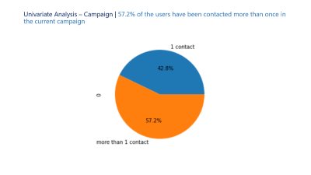
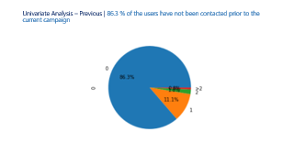
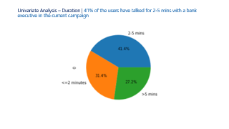
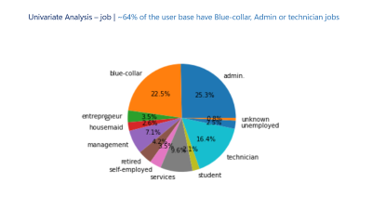
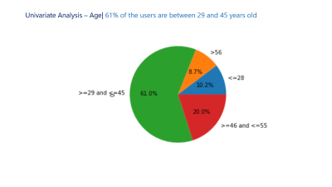
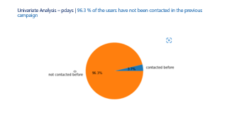
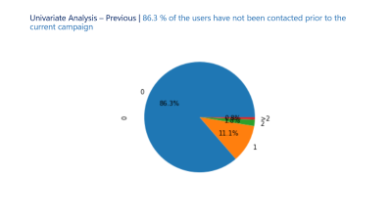

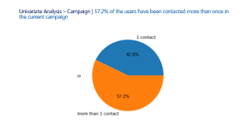


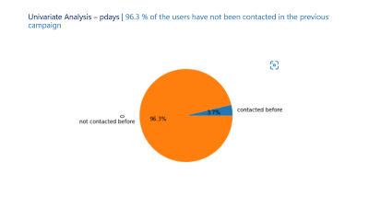
Univariate Analysis | After cleaning the data, univariate analyses were performed to analyze the independent characteristics of each variable in the data
Age 61% of the users are between 29 and 45 years old
Previous
86.3 % of the users have not been contacted prior to the current campaign
Duration
41% of the users have talked for 2-5 mins with a bank executive in the current campaign
Pdays
96.3 % of the users have not been contacted in the previous campaign
Campaign
57.2% of the users have been contacted more than once in the current campaign
Job
~64% of the user base have Blue-collar, Admin or technician jobs

Slide 17
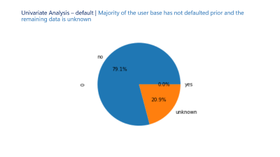
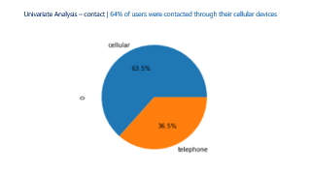
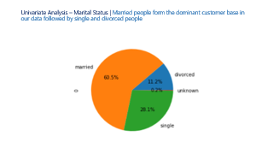
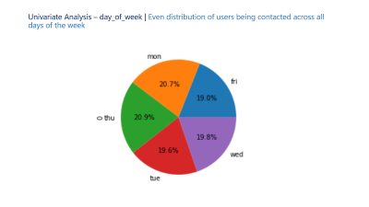
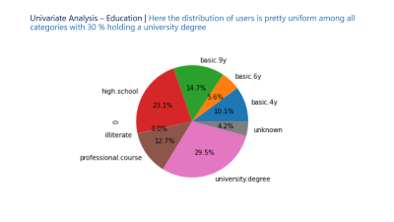
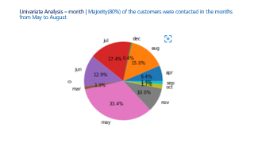
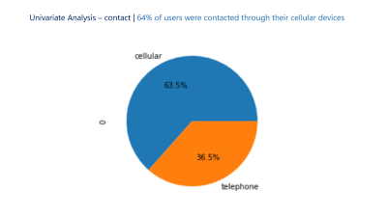


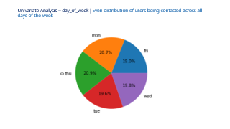
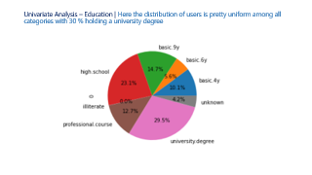
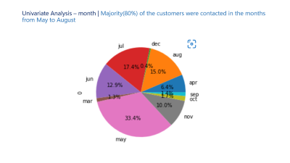
Univariate Analysis | After cleaning the data, univariate analyses were performed to analyze the independent characteristics of each variable in the data
Education
The distribution of users is pretty uniform among all categories, 30 % hold a university degree
Contact
64% of users were contacted through their cellular devices
Marital
Married people form the dominant customer base followed by single and divorced people
Month
Majority(80%) of the customers were contacted in the months from May to August
Default
Majority of the user base has not defaulted prior and the remaining data is unknown
Day of Week
Even distribution of users being contacted across all days of the week

Slide 18
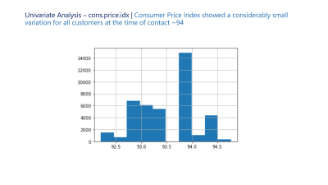
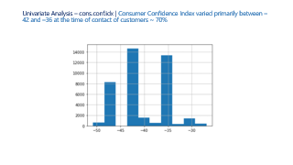
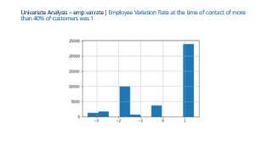
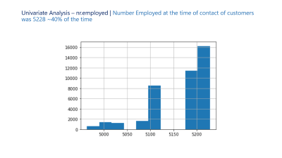
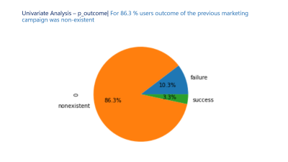
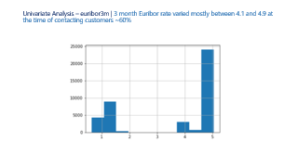
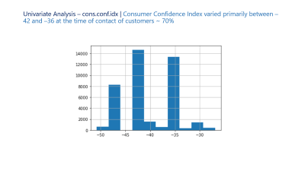
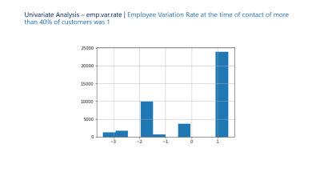



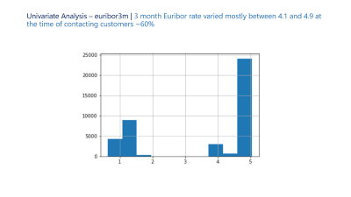
Univariate Analysis | After cleaning the data, univariate analyses were performed to analyze the independent characteristics of each variable in the data
P outcome
For 86.3 % users outcome of the previous marketing campaign was non-existent
Cons Conf Idx
ConsumerConfidence Index varied between –42 and –36 at the time of contact of customers ~ 70%
Emp Var Rate
Employee Variation Rate at the time of contact of more than 40% of customers was 1
Euribor3m
3 month Euribor rate varied between 4.1 and 4.9 at the time of contacting customers ~60%
Cons Price Idx
Consumer Price Index showed a small variation for all customers at the time of contact ~94
Nr Employed
Number Employed at the time of contact of customers was 5228 ~40% of the time

Slide 19
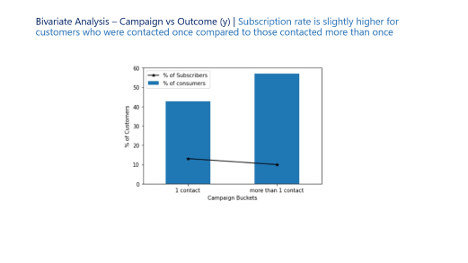
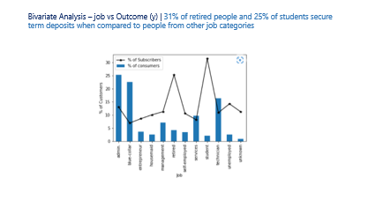
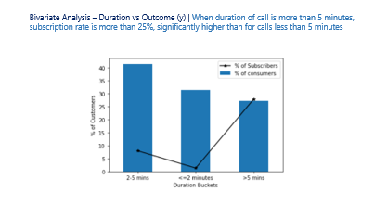
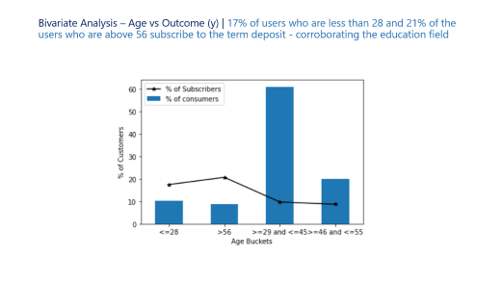
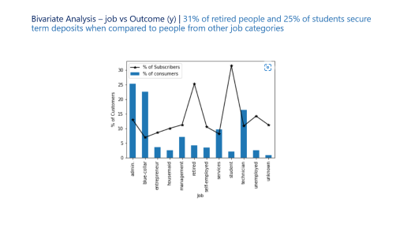
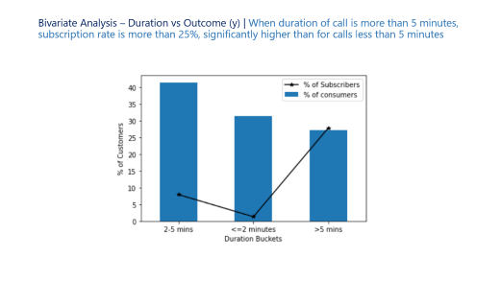
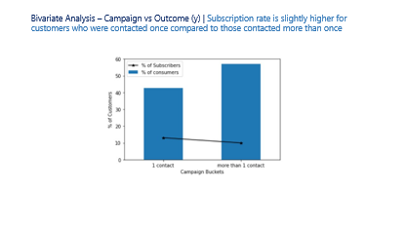
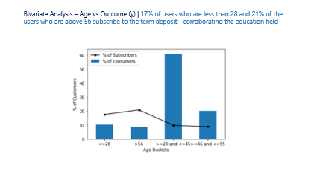
Bivariate Analysis | Bivariate analyses were performed to understand how each variable affects the outcome variable i.e. securing a deposit

Slide 20
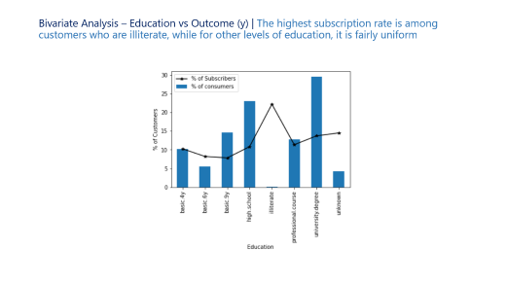
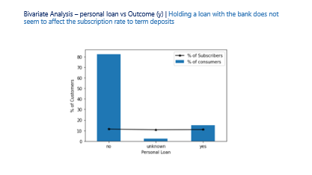
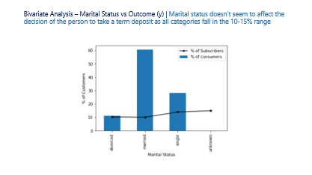
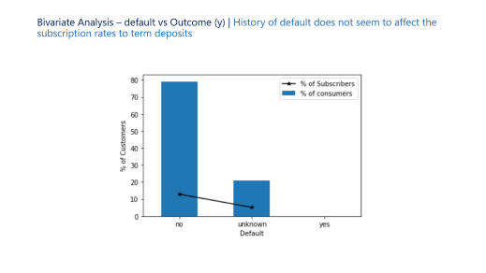
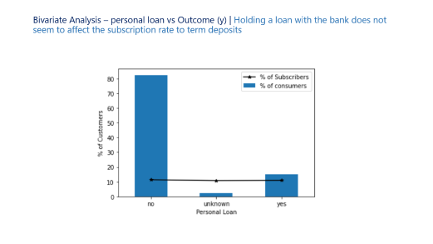
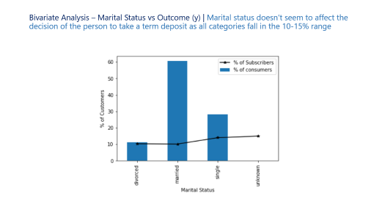
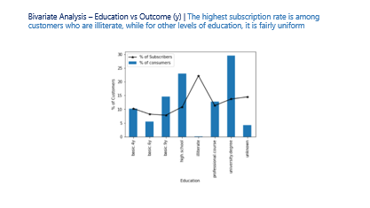
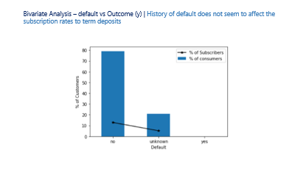
Bivariate Analysis | Bivariate analyses were performed to understand how each variable affects the outcome variable i.e. securing a deposit

Slide 21
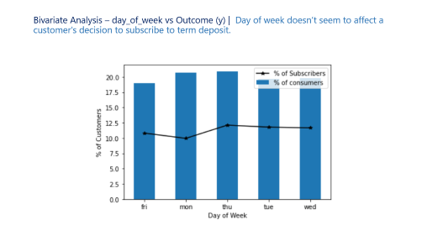
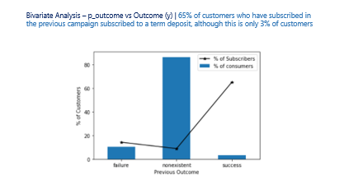
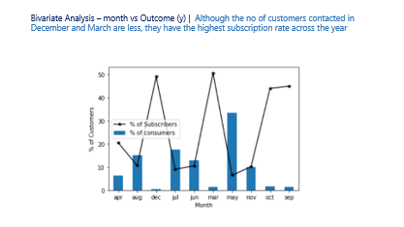
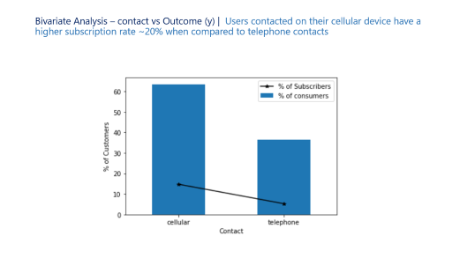
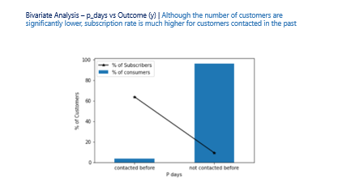
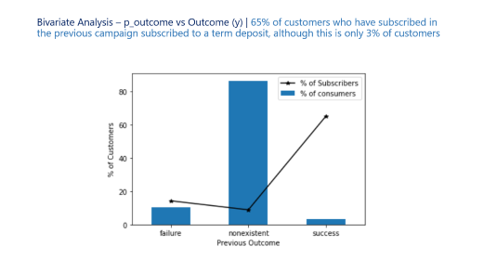




Bivariate Analysis | Bivariate analyses were performed to understand how each variable affects the outcome variable i.e. securing a deposit

Slide 22








Customer Tailored Approach – The Bankable Student | Based on further deep dives, students have been identified as high potential customers for term deposits

Slide 23








Customer Tailored Approach – The Bankable Student | Based on further deep dives, students have been identified as high potential customers for term deposits

Slide 24

Segmentation & Targeting

Slide 25



Cluster potential consumer bases
The dataset used includes consumers with diverse characteristics in terms of- demographic, campaign responses and socio-economic data.
Customer data is segmented into five clusters where each segment contains customers with similar campaign responses.
Clustering analysis identifies segments based on customer behavior and their conversion rates. This helps the bank devise a unique targeting strategy for each of the segments

Slide 26






Customer Tailored Approach – The Bankable Student | Based on further deep dives, students have been identified as high potential customers for term deposits
BANKABLE STUDENT
Plan of Action
Key Factors
March Madness – March is the best time to reach out to students as conversion is highest
Talk More, But Carefully – Calls over 2 minutes have higher subscriptions rates, but students tend to be more impatient than other groups
Telephone – Cellular contact has the highest success rate among students, even in comparison to other groups. Texts and direct calls are recommended.
History Counts - Students that have been contacted before have higher rate of subscription. Raising brand and product awareness could result in a similar effect on subscription rate.
Job
Month of Contact
Call Duration
Profile
College student looking to invest money in safe opportunities
Career potential can mean these are high value customers
Mode of Contact
Previous Contact (Y/N)

Slide 27

Customer Tailored Approach – The Reliable Elder | Based on further deep dives, retired customers have been identified to have high likelihood to secure term deposits
RELIABLE ELDER
Plan of Action
Key Factors
Festive Finances – December is the best time to reach out to elders as conversion is highest
Rambling is Good – Calls over 2 minutes have higher subscriptions rates, as senior citizens tend to be thorough and appreciate time offered and personal assistance
‘Cell’ It To Me – Cellular contact has the highest success rate among retirees
Loyalty Doesn’t Retire – Retirees that have been contacted before have highest subscription rates likely due to having loyalty formed over a long relationship with the bank
Job
Month of Contact
Call Duration
Profile
Retired professionals looking for low-effort medium-return investment
Large amounts of savings accumulated over a long career
Mode of Contact
Previous Contact (Y/N)

Slide 28

Predicting conversion rates

Slide 29
Statistical tests
ANOVA and Chi square test analysis identified factors that are significant in response to the outcome
Categorical variables such as “loan” and “house” are found to be insignificant and hence dropped from further analysis.
SMOTE (Synthetic Minority Over-sampling technique) handles imbalance in target class (subscription flag), thereby reducing false negatives.

Slide 30



Predict subscription likelihood
As one of the biggest sources of income for banks, term deposits provide banks with the cash flow they need to lend money to other institutions at a higher interest rate
Demographic, campaign response and macro-economic data was aggregated at the customer level to build a model that predicts likelihood of conversion
The analysis employed various sampling techniques, established feature importance through statistical tests and culminated with building sophisticated predictive models

Slide 31





Results & findings
Statistical tests (ANOVA and CHI-SQUARE) revealed that the information regarding housing and personal loan did not affect the outcome
Gradient boosting models (light GBM) recorded the best accuracy on the test pool of customers and is recommended to ascertain the outcome on a future pool of customers
The framework aims to reduce marketing spend by reducing the number of calls, promotions and optimizes other customer outreach approaches based on customer profiles
Performance |  | ACTUALS
 |  | Yes | No
PREDICTED | Yes | 88% | 4%
 | No | 2% | 6%
84%
95%
86%
89%

Slide 32

RECOMMENDATIONS and areas of potential

Slide 33
RECOMMENDATIONS
Use a predictive approach to identify the consumers that have a high likelihood to subscribe to term deposit.
Use differentiated marketing strategies to appeal to distinct customer segments.
Leverage other communication channels like email and regional TV advertising to improve outreach
Consider itemizing the product to cater to various customer profiles

Slide 34




BUSINESS IMPACT
MARKETNG EFFORTS
Selective targeting increases the Return on Ads spent
Wider availability of resources
CUSTOMER EVALUATION
Framework to evaluate the customer based on acquisition and generate insights
CROSS AND UP SELLING
Persuade targeted clients into purchasing other funds and insurance products along with term deposits

Slide 35
Going Forward | To further flesh out the insights and recommendations being generated, we need access to more data that will close gaps that exist in the current analysis
FUTURE SCOPE
Effect of Macro Economic Variables
Areas of Potential
The prevalent economic conditions during the campaign, contribute towards its success in a big way, as seen in the analysis
There trends are very apparent and the exact reasons or understanding of why it happens is not clear
To plug the gaps in our understanding, we need more data regarding the time period of campaign
During the analysis certain large customer groups were identified with low subscription rates. Targeting these customers with different strategies that can be identified through test groups will be valuable.
Married people between 29 & 45 with blue collar jobs – 10% of data; Subscription rate only 6%
Married people between 29 & 45 with services jobs – 4% of data; Subscription rate only 8%
Fin.

Slide 36

THANK YOU!

Slide 37
APPENDIX

Slide 38

Univariate Analysis – Age| 61% of the users are between 29 and 45 years old

Slide 39

Univariate Analysis – Duration | 41% of the users have talked for 2-5 mins with a bank executive in the current campaign

Slide 40

Univariate Analysis – Campaign | 57.2% of the users have been contacted more than once in the current campaign

Slide 41

Univariate Analysis – Previous | 86.3 % of the users have not been contacted prior to the current campaign

Slide 42

Univariate Analysis – pdays | 96.3 % of the users have not been contacted in the previous campaign

Slide 43

Univariate Analysis – job | ~64% of the user base have Blue-collar, Admin or technician jobs

Slide 44

Univariate Analysis – Education | Here the distribution of users is pretty uniform among all categories with 30 % holding a university degree

Slide 45

Univariate Analysis – Marital Status | Married people form the dominant customer base in our data followed by single and divorced people

Slide 46

Univariate Analysis – default | Majority of the user base has not defaulted prior and the remaining data is unknown

Slide 47

Univariate Analysis – contact | 64% of users were contacted through their cellular devices

Slide 48

Univariate Analysis – month | Majority(80%) of the customers were contacted in the months from May to August

Slide 49

Univariate Analysis – day_of_week | Even distribution of users being contacted across all days of the week

Slide 50

Univariate Analysis – p_outcome| For 86.3 % users outcome of the previous marketing campaign was non-existent

Slide 51

Univariate Analysis – emp.var.rate | Employee Variation Rate at the time of contact of more than 40% of customers was 1

Slide 52

Univariate Analysis – cons.price.idx | Consumer Price Index showed a considerably small variation for all customers at the time of contact ~94

Slide 53

Univariate Analysis – cons.conf.idx | Consumer Confidence Index varied primarily between –42 and –36 at the time of contact of customers ~ 70%

Slide 54

Univariate Analysis – euribor3m | 3 month Euribor rate varied mostly between 4.1 and 4.9 at the time of contacting customers ~60%

Slide 55

Univariate Analysis – nr.employed | Number Employed at the time of contact of customers was 5228 ~40% of the time

Slide 56

Bivariate Analysis – Age vs Outcome (y) | 17% of users who are less than 28 and 21% of the users who are above 56 subscribe to the term deposit - corroborating the education field

Slide 57

Bivariate Analysis – Duration vs Outcome (y) | When duration of call is more than 5 minutes, subscription rate is more than 25%, significantly higher than for calls less than 5 minutes

Slide 58

Bivariate Analysis – Campaign vs Outcome (y) | Subscription rate is slightly higher for customers who were contacted once compared to those contacted more than once

Slide 59

Bivariate Analysis – job vs Outcome (y) | 31% of retired people and 25% of students secure term deposits when compared to people from other job categories

Slide 60

Bivariate Analysis – Education vs Outcome (y) | The highest subscription rate is among customers who are illiterate, while for other levels of education, it is fairly uniform

Slide 61

Bivariate Analysis – Marital Status vs Outcome (y) | Marital status doesn’t seem to affect the decision of the person to take a term deposit as all categories fall in the 10-15% range

Slide 62

Bivariate Analysis – default vs Outcome (y) | History of default does not seem to affect the subscription rates to term deposits

Slide 63

Bivariate Analysis – personal loan vs Outcome (y) | Holding a loan with the bank does not seem to affect the subscription rate to term deposits

Slide 64

Bivariate Analysis – contact vs Outcome (y) | Users contacted on their cellular device have a higher subscription rate ~20% when compared to telephone contacts

Slide 65

Bivariate Analysis – month vs Outcome (y) | Although the no of customers contacted in December and March are less, they have the highest subscription rate across the year

Slide 66

Bivariate Analysis – day_of_week vs Outcome (y) | Day of week doesn’t seem to affect a customer's decision to subscribe to term deposit.

Slide 67

Bivariate Analysis – p_outcome vs Outcome (y) | 65% of customers who have subscribed in the previous campaign subscribed to a term deposit, although this is only 3% of customers

Slide 68

Bivariate Analysis – p_days vs Outcome (y) | Although the number of customers are significantly lower, subscription rate is much higher for customers contacted in the past

Slide 69

Bivariate Analysis – nr.employed buckets vs Outcome (y) | Low nr.employed buckets are related with high levels of conversion rates although the volumes are low

Slide 70

Deep Dive – Students | Students contacted during months except May and July have sufficient conversion rates with March showing the highest value

Slide 71

Deep Dive – Students | Term deposit conversion rates are higher for students contacted on cellular mode in all months except May and July

Slide 72

Deep Dive – Students | The highest conversion rate is found in these months when the call duration is over two minutes for students contacted on cellular mode

Slide 73

Deep Dive – Students | For students contacted using cellular in these months for over two minutes, conversion rate is highest when they have been contacted before

Slide 74

Deep Dive – Retired | Retirees contacted during months except May to August have sufficient conversion rates with December showing the highest value

Slide 75

Deep Dive – Retired | Term deposit conversion rates are higher for retirees contacted on cellular mode in all months except May to August

Slide 76

Deep Dive – Retired | The highest conversion rate is found in these months when the call duration is over two minutes for retirees contacted on cellular mode

Slide 77

Deep Dive – Retired | For retirees contacted using cellular in these months for over two minutes, conversion rate is highest when they have been contacted before

Slide 78

Deep Dive – Decision Tree Analysis | To augment the deep dives that were performed, a decision tree was modelled that statistically chose relevant factors affecting conversion rate

